Slide 1
Monitoring basics with Prometheus и GRaFana
Custom metrics
Kube-prometheus-stack

Slide 2
Tools
Minikube
Helm

Slide 3
Kube-prometheus-stack
Prometheus Operator
Grafana
Alert Manager

Slide 4
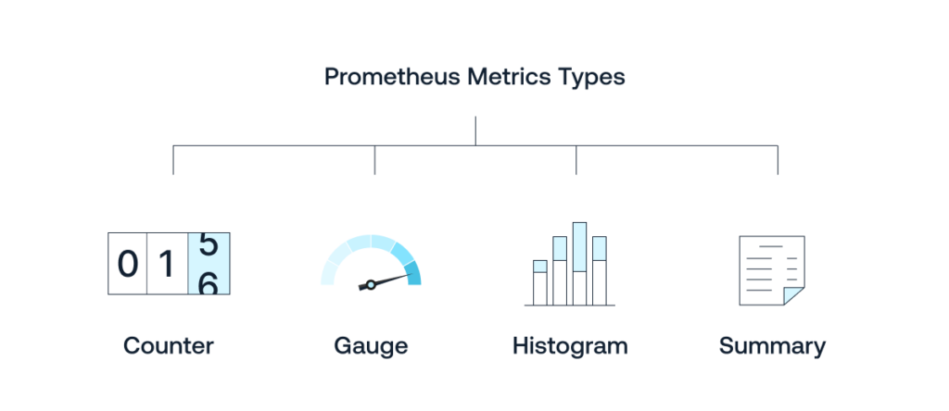
PROMQL
Metric types:

Slide 5
Links
kube-prometheus-stack
kube-prometheus-stack default config
PromQL basics
Exporters: Flask Prometheus Exporter Spring Boot Prometheus Prometheus .NET
Tutorial github code:
https://github.com/ybaryshnikova/monitoring-meetup
https://github.com/ybaryshnikova/prometheus-metrics-example

